Slide 1








A Moment for Philanthropy in Civic Learning
Webinar
January 25, 2017

Slide 2
Why We Need to Provide Quality Civic Learning for All
Kei Kawashima-Ginsberg

Slide 3
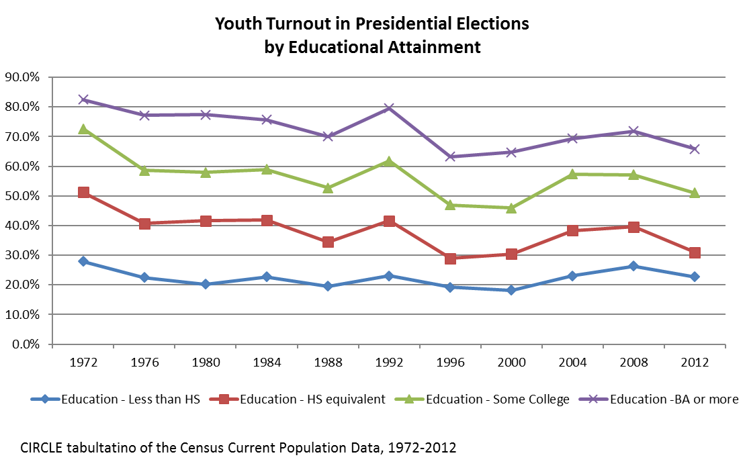
Diverse Generation – Large Gaps in Civic Engagement

Slide 4
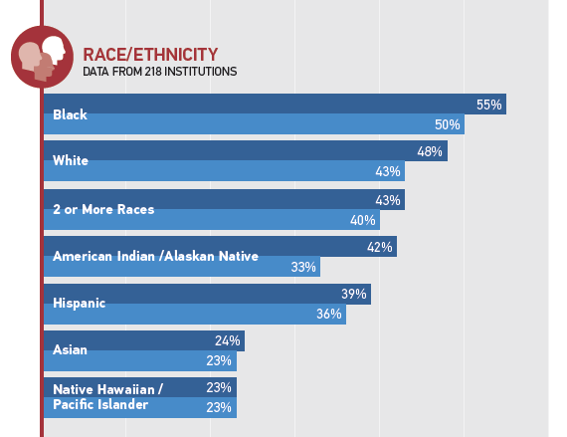

Even Among College Students, Racial Disparities Persist
NSLVE Data, from Institute for Democracy in Higher Education (IDHE) – 2012 Voter Turnout

Slide 5
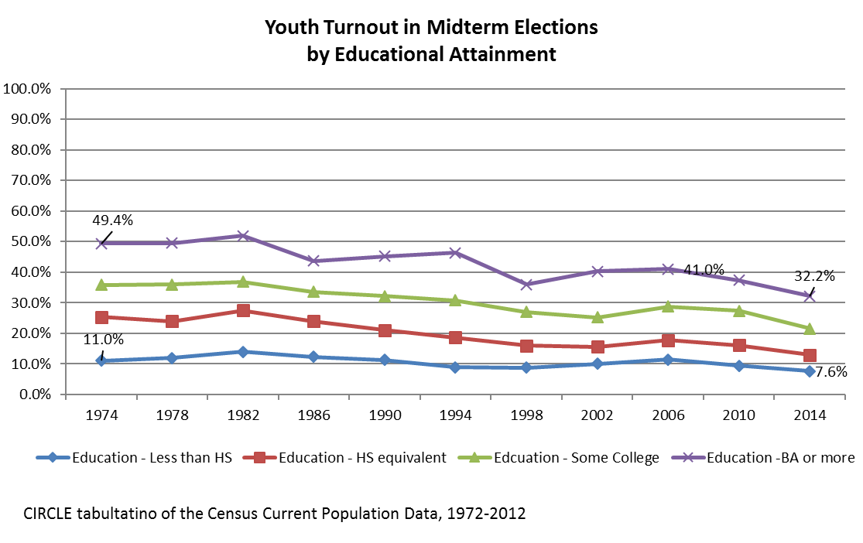
Presidential-Midterm Engagement Gap
Notes:
Now here is a midterm voter turnout historical graph – what you should notice is that suddenly, no group of young people, regardless of education, turnout at above 1/3, and the turnout is less than that of the presidential turnout for every group, less than half, in fact, and while the presidential turnout has been basically flat with some bumps here and there, midterm turnout is on a steady decline, and it has not improved. In other words measuring youth civic and political engagement by presidential turnout alone makes us miss an important question – how robust is our young people’s civic commitment and identity?

Slide 6




Case for News Literacy Education
Filter Bubbles & Echo Chamber
Motivated Reasoning
Decreased Ability to seek and assess news media
Political Polarization
Technology & Cable News
Knowledge alone does not help
Media lit education helps
Model developed from Kahne & Bowyer, 2016
Notes:
Conversations News and media litereacy Shifts in the media environment
Cable TV and Internet grew influential
Echo chamber and filter bubbles
Consuming media can simply confirm existing biases
Vulnerability to misinformation
These shifts related to increased political polarization
Increase in “motivated reasoning” which then affects (Kahne & Bowyer 2016)
Ability to assess media validity accurately
Political knowledge alone not enough to overcome motivated reasoning
Experience with media literacy education buffers effects of motivated reasoning
Much more needs to be done to support development of strong news lit ed, and evaluation of these efforts.
Studies so far scratched the surface

Slide 7
Levels of Trust Among Millennials, By Race and Ethnicity
Notes:
This sort of divide was seen along the racial, gender, geographical, educational and partisan lines, although Millennials are the most diverse generation to date, that diversity did not make them immune to deep divides, in how they see our society, whom to trust.

Slide 8
Learning to Work Across Differences
Political Polarization increasing
Millennials deeply divided
Organic sites for building “bridging capital” eroded
How to change course?
  Civic education as a practice for the democracy
  Expand learning opportunities
  Equitable access to high quality civic learning
Notes:
“Civic education” must go beyond strengthening knowledge of our systems, laws, and the Constitution
Need to create and support opportunities to develop key civic skills in multiple settings, through diverse pathways and methods

Slide 9
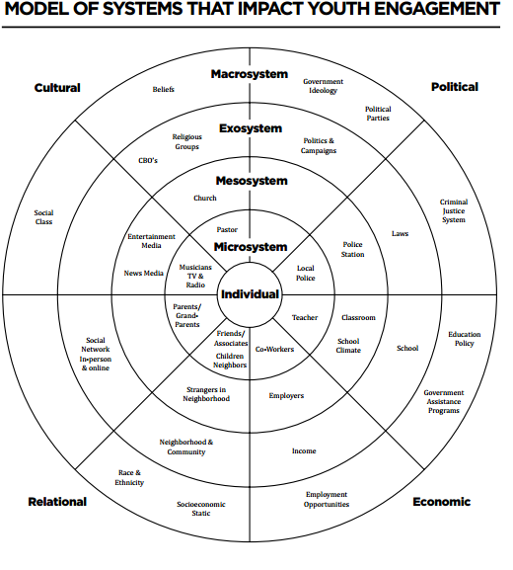
Levers of Civic Learning
  K-12 Civic Education
  Family & Friends
  Neighborhood
  Vocational training/internships
  School Climate
  Community-Based Organizations
  Policy
Notes:
We know from an extensive literature review that young people’s civic development can impacted and influenced in various ways – anything from very localized experiences (like interactions in neighborhoods, school climate) to something like public policy.

Slide 10


Scott Warren

Slide 11

Why now?
Not about election results, but the entirety of the election
People more interested in youth civic engagement than we’ve seen
How do we sustain this attention?
What are different groups doing?
How can we rebuild the foundations of our democracy?
Will not happen overnight
11

Slide 12
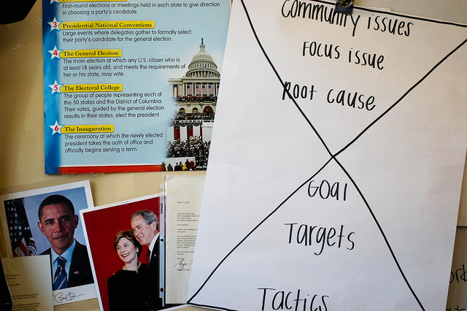
GC Action Civics Framework:
The Advocacy Hourglass

Slide 13
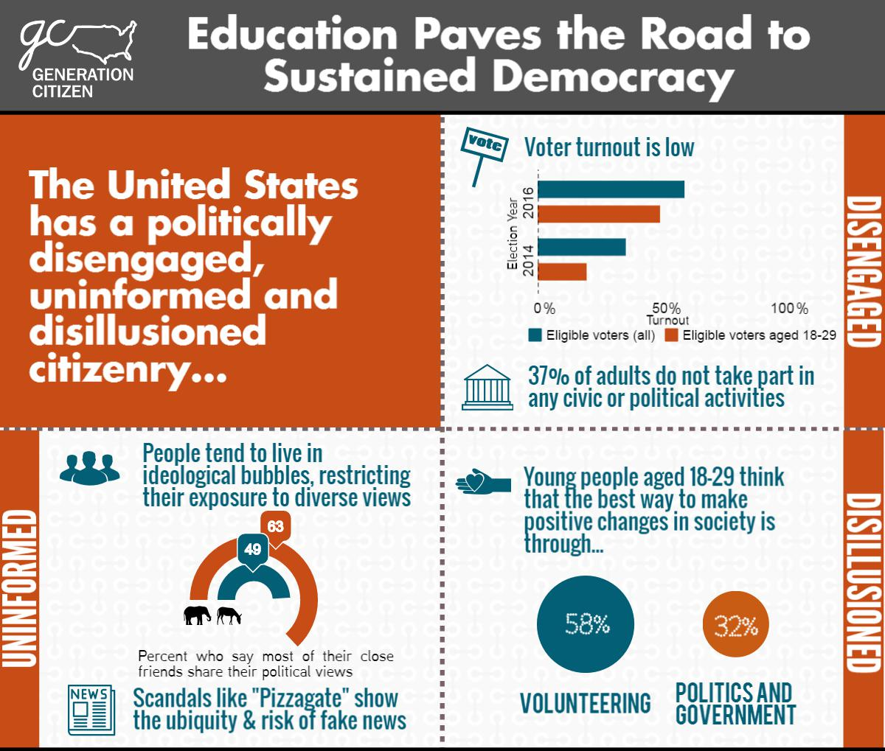

Slide 14
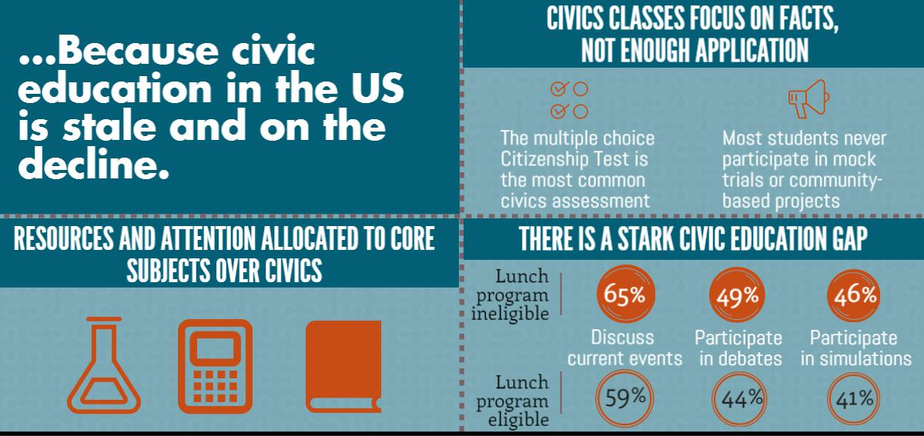

Slide 15
Different Solutions
Balancing content with action
Action civics education
Policy solutions
  Vote16
  Encouraging youth vote
  State civics education legislation
Youth organizing
At all efforts, keeping youth front and center

Slide 16
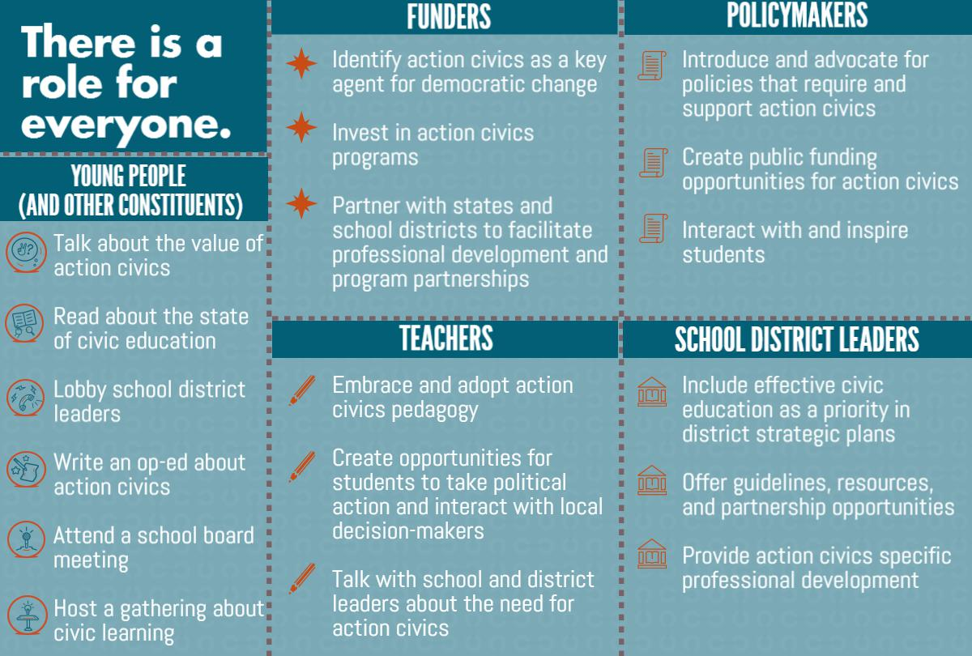

Slide 17
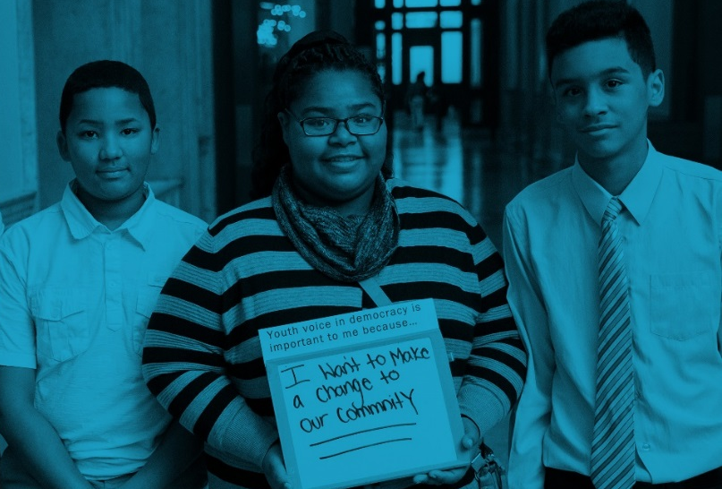
“Being as young as I am, I’ve been told that I don’t really have a place in politics, that my voice is insignificant, that no one would ever listen. Oh, the lies they’ve told me. Truth be told, my voice matters, it matters a lot, and because of Generation Citizen I’ve had the opportunity to not only voice my opinion, but to have it heard.”
Miaija Jawara, Former GC student at A. Phillip Randolph Campus High School in Harlem, New York and Community Change Fellow alumnus

Slide 18
Action Civics
Brian Brady and Stormie McNeal
Democracy is a Verb!

Slide 19
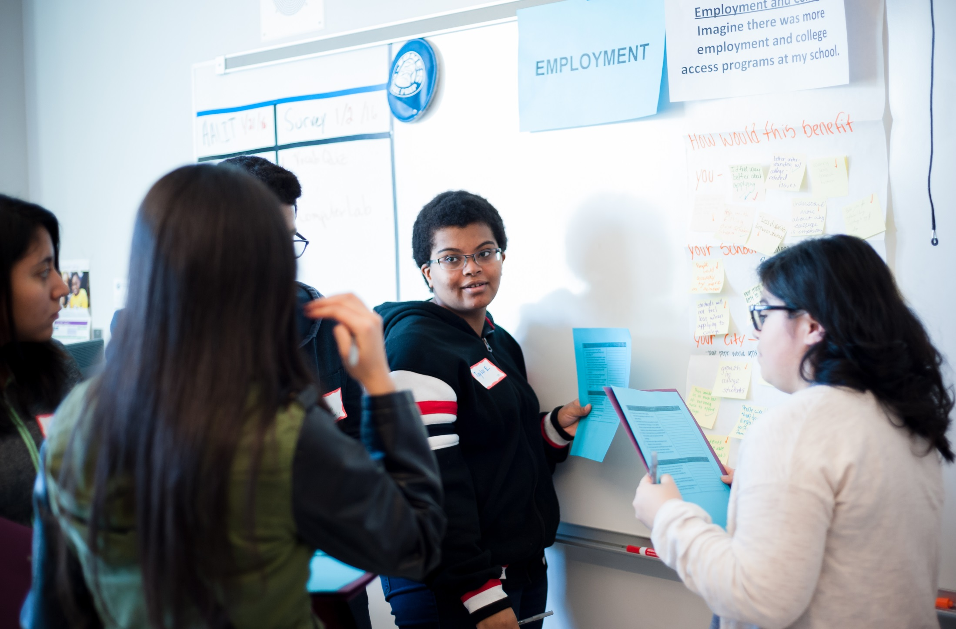

Slide 20
Why Action Civics?
Being an effective global citizen in 2017 requires:
Civic skills
Civic agency
Civic knowledge
Practice
Traditional civics instruction often fails to inspire and develop real world civic skills.

Slide 21
Young People Losing Faith in Government and Democratic Process
20% of 18-29 year olds voted in 2014 election
50% of young people believe the justice system is racially and ethnically biased
66% of African American youth have little or no confidence in the police
Action Civics for Some – Research shows that quality civic learning opportunities are not provided equally to low income students and youth of color

Slide 22
What is Action Civics?
Youth Voice and Choice
Youth-led Community and Issue Analysis
Youth-led Research and Deliberation
Youth Participating in Policymaking and Elections
Real World Advocacy for Youth Created Solutions

Slide 23
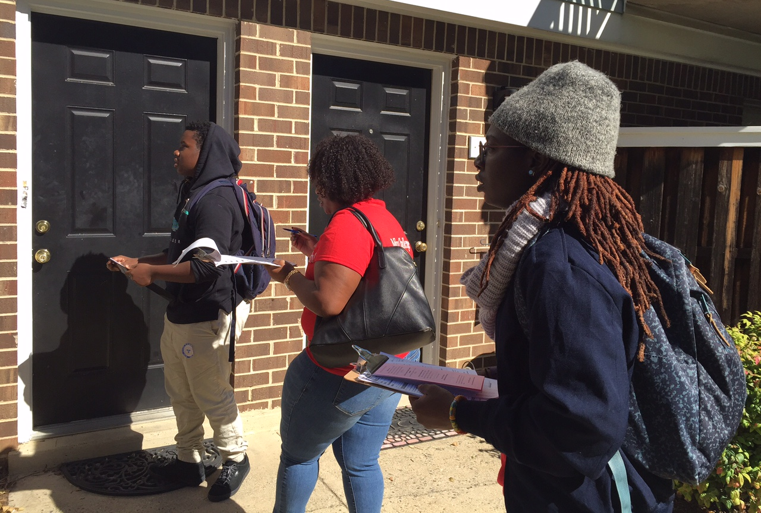

Slide 24
Mikva’s Comprehensive Framework for Action Civics
  Elections in Action program
  Youth Policymaking councils
  Issues to Action classrooms/after school clubs
  Action civics training and coaching for teachers
  Quality action civics curriculum in Activism, News Literacy and Elections

Slide 25
Issues to Action Process
1. Examine
Community
6. Take Action
2. Identify
Issues
Reflection
5. Develop Strategies
3. Conduct Research
4. Analyze
Power
* Step Zero is Teambuilding and Leadership Development

Slide 26
Why does Action Civics Work?
Built on strong pedagogical foundation emphasizing project- based learning and real world issues (apprenticeship model)
Addresses root problem of civic disengagement: youth’s sense of powerlessness and civic cynicism
Respects youth voice and builds youth power
Respects teachers and adds value to their work
It’s fun and has immediate impacts!

Slide 27
Mikva Action Civics Impacts
87% of Mikva alumni believe they have the power to make a difference on issues that are important to them
Alumni vote at 7 times the rate of their peers and 88% of alumni are registered voters
Alumni volunteering in elections at 16 times the rate of their peers (33% to 2%)
80% of alumni are interested in following government and public affairs
91% of alumni report improved teamwork, critical analysis, and strengthened collaboration skills through action civics

Slide 28
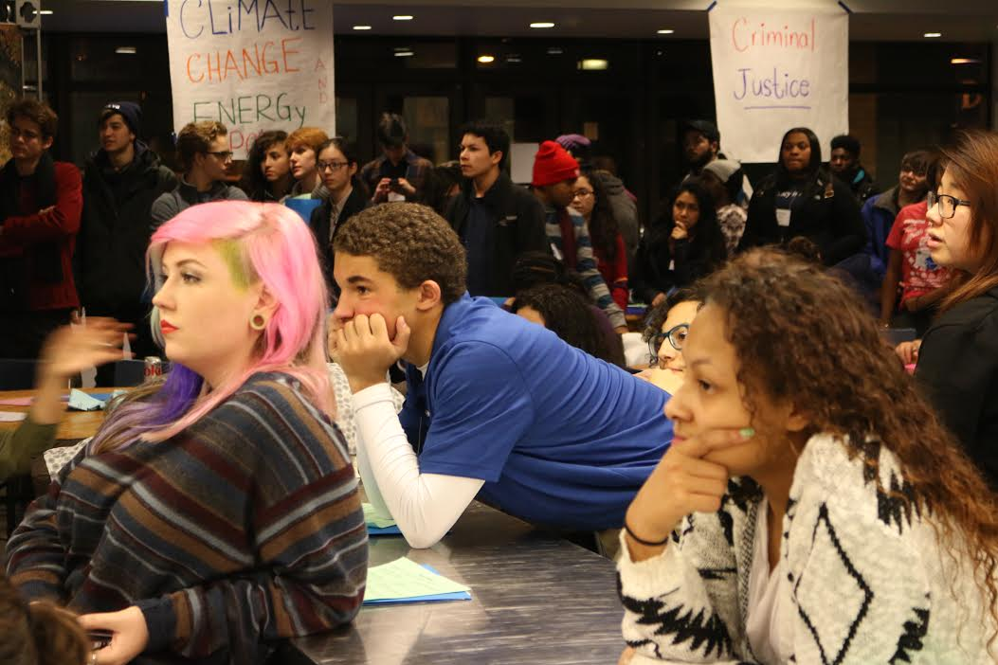

Slide 29
Why Invest in Action Civics?
Action Civics has scale because it can work inside and outside of classrooms
Action Civics is cost effective because it builds capacity of teachers and schools
Action Civics builds on existing community assets and strategies
Action Civics is non partisan and fits into various educational paths and settings

Slide 30


Bringing Civics Back to Illinois Schools
Shawn Healy

Slide 31
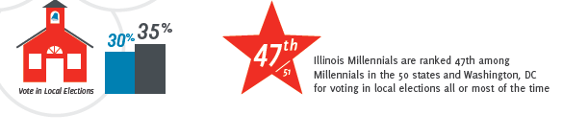

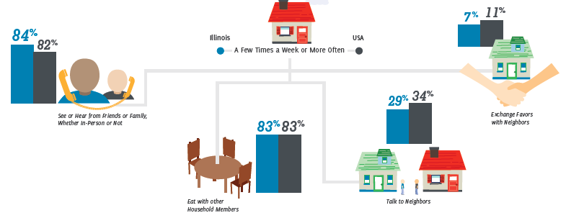
Illinois high school graduates are ill-prepared for civic life

Slide 32
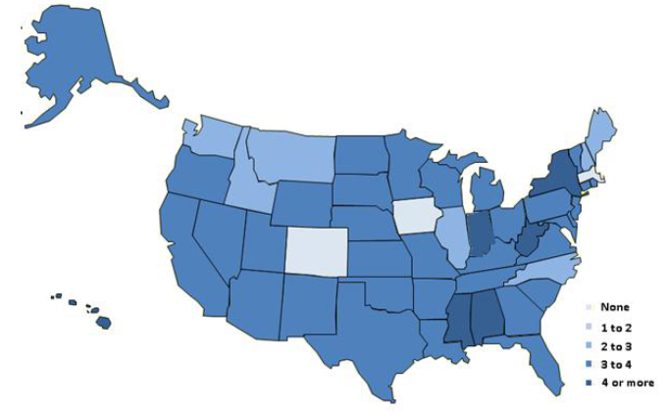
Illinois has one of the lowest credit requirements for social studies

Slide 33
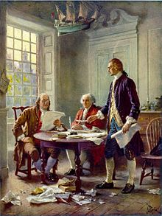
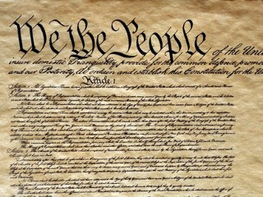
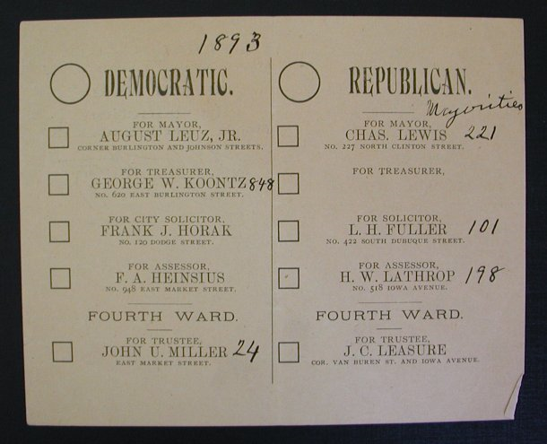
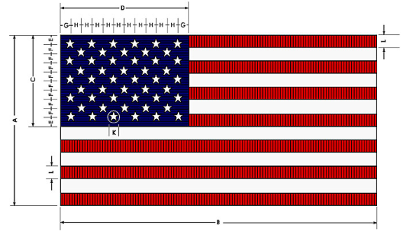
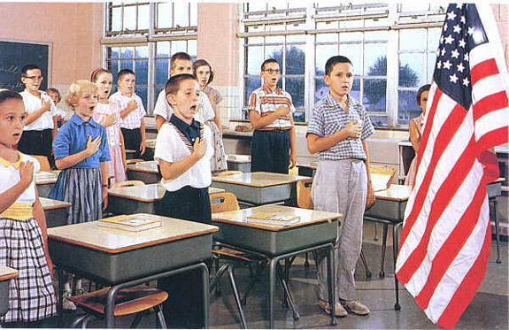
And civic learning is little more than window dressing
The Illinois School Code requires instruction in patriotism and the principles of representative government:

Slide 34
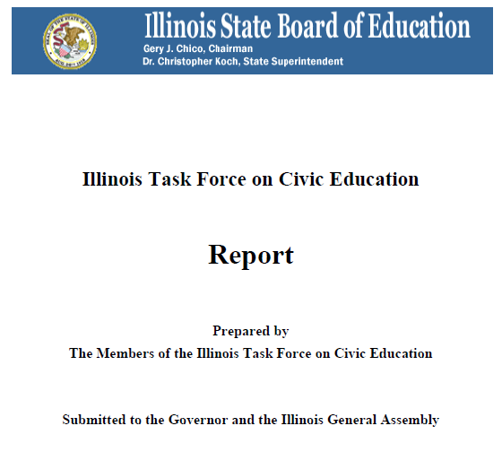
The Illinois Civic Education Task Force made a series of policy recommendations
  Recommendations:
  Civics course requirement
  Revisions of Illinois Social Science
  Standards
  Project-based/ Service-learning
  requirement
  4. Licensure and certification of civics
  teachers
  5. Professional development
  6. Student involvement in elections

Slide 35
A civics course requirement was priority number one
  House Bill 4025 was signed into law by Governor Rauner on August 21, 2015:
  Requires a semester long civics course in addition to the current yearlong US History/ Government requirement
  Course content:
    Instruction on government institutions
    Current and controversial issues discussions
    Service-learning
    Simulations of democratic processes
  Effective date: July 1, 2016 and applies to incoming freshmen for the 2016-17 school year

Slide 36
Most Illinois high schools already require civics or government

Slide 37
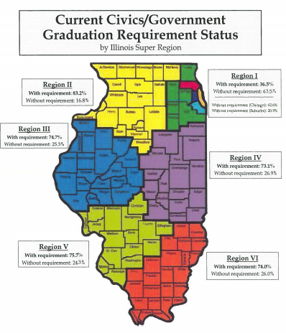
Civics/ government course requirements vary by region

Slide 38
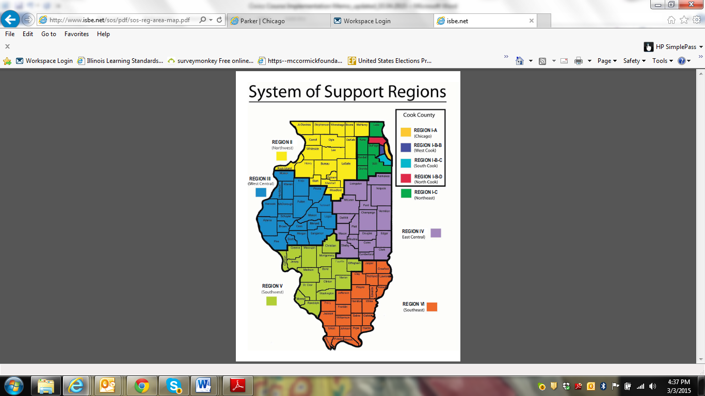
Best practices in civic learning are prevalent with the exception of service-learning

Slide 39
Lack of support for teacher professional development is a major challenge

Slide 40
Our implementation models attempts to address these deficiencies
Funding Community
Led by the McCormick Foundation, leverage existing and emerging resources; support coordination between partners
Institutional Partners
Determine local needs; recruit teacher mentors; host teacher professional development opportunities
Civic Education Nonprofits
Provide professional development on proven civic learning practices
Teacher Mentors
Co-facilitate professional development and mentor schools

Slide 41
Ian Simmons

Slide 42
Vote16: Supporting Efforts to Lower the Voting Age to 16 on the Local Level
Why Vote16?
  Voting is habitual, and 16 is the best time to establish the habit
  Drive demand for improved civics education
  Give youth a meaningful voice on local issues
Two cities in Maryland have 16-year-old voting, and more than 12 countries

Slide 43
Vote16: Our Progress
Laying Groundwork and Generating Attention
  White paper with legal research
  Website (Vote16USA.org)
  Youth Advisory Board
  More than 100 media hits
2016 Campaigns
  San Francisco ballot measure earned more than 172,000 votes to finish at 48%
  Berkeley ballot measure for school board elections won with 70%

Slide 44
Vote16: Current Work and Future Goals
Supporting emerging campaigns and working with interested legislators in multiple states
Goals:
  Win multiple ballot measure campaigns in 2018/2020
  Bring the policy idea further into the mainstream
  Keep youth voice at the center

Slide 47
Oliver York
Youth Leader

Slide 48
Youth Organizing
Eric Braxton

Slide 49
What is Youth Organizing?
Community based organizations engage young people during out of school time
Engage mainly low-income young people of color
Young people themselves are primary decision makers
Support young people in developing leadership, social and emotional, and academic skills
Engage young people themselves in identifying issues and taking collective action

Slide 50
Youth Engagement Continuum
INTERVENTION
DEVELOPMENT
COLLECTIVE EMPOWERMENT
SYSTEMIC CHANGE
Youth Services Approach
Youth
Development
Youth
Leadership
Civic
Engagement
Youth
Organizing
 |  | Includes components of youth development approach plus: | Includes components of youth development & youth leadership plus: | Includes components of youth development, youth leadership and civic engagement plus:
Defines young people as clients Provides services to address individual problems and pathologies of young people Programming defined around treatment and prevention | Provides services and support, access to caring adults and safe spaces Provides opportunities for growth and development of young people Meets young people where they are Builds young people’s individual competencies Provides age-appropriate support Emphasizes positive self-identity Supports youth-adult partnerships | Builds in authentic youth leadership opportunities within programming and organization Helps young people deepen historical and cultural understanding of their experiences and community issues Builds skills and capacities of young people to be decision makers and problem solvers Youth participate in community projects | Engages young people in political education and awareness Builds skills and capacity for power analysis and action around issues young people identify Begins to help young people build collective identity of young people as social change agents Engages young people in advocacy and negotiation | Builds a membership base Involves youth as decision makers Engages in collective action for systems change Engages in alliances and coalitions

Slide 51

Community Level Impacts
Districts across CA approve college prep for all.
LA, Chicago, Philadelphia, Boston pass new student codes of conduct.
Changing school food in San Antonio, Baltimore, and New Orleans.

Slide 52
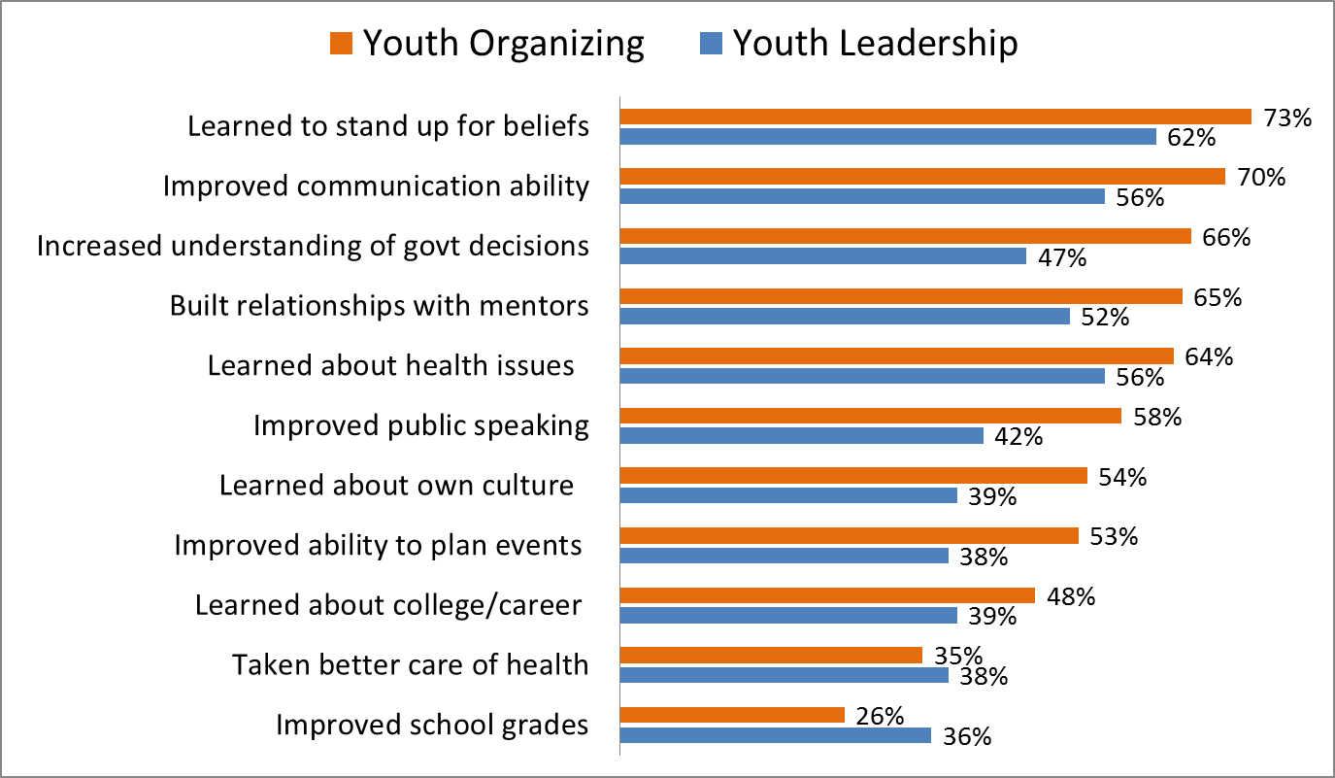
Percentage of Youth Benefiting “A Lot” from Youth Organizing & Youth Development Groups
Building Healthy Communities Initiative in California 2014
Youth Organizing
Youth Development
N=1149

Slide 53
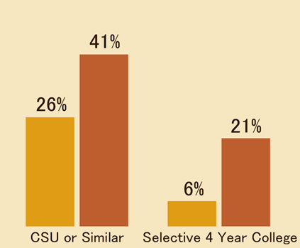

High School Youth Organizing and College Enrollment:
Youth organizing is associated with an increased likelihood of attending a four year college
Based on logistic regression results controlling for high school GPA, socioeconomic background, and gender
N=2610
Findings published in Learning to Lead: The Impact of Youth Organizing on the Educational
and Civic Trajectories of Low-Income Youth available at: http://idea.gseis.ucla.edu/projects/learning-to-lead

Slide 54
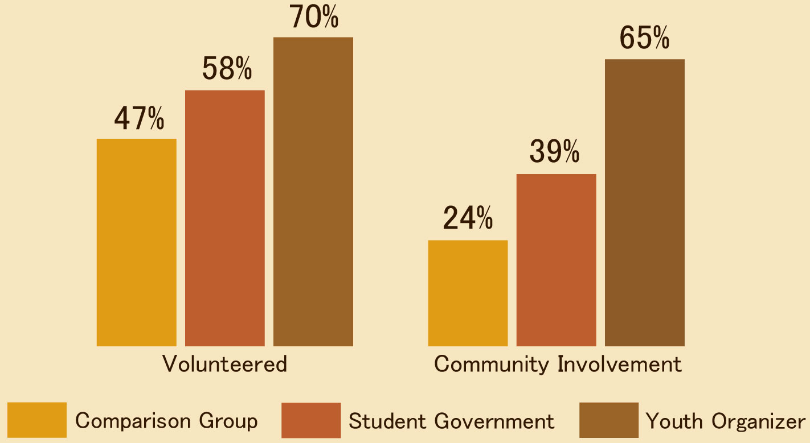
Civic Participation in Young Adulthood:
Youth organizing generates high levels of participation
(Analyses control for socioeconomic background, college enrollment, gender, and age)
N=2610
Findings published in “Training Young Activists: Grassroots Organizing and Youths’ Civic and Political Trajectories.” Sociological Perspectives

Slide 55
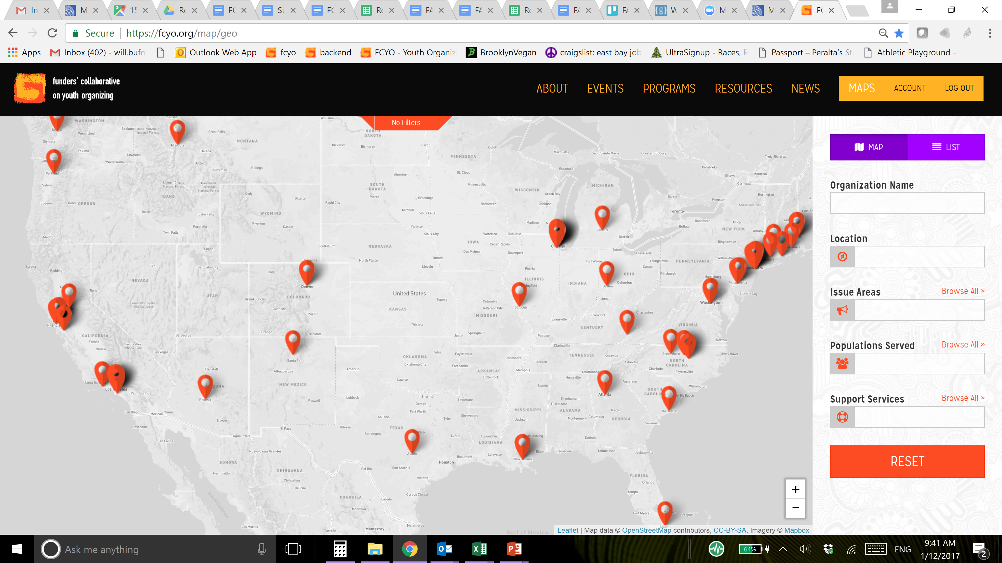
Youth Organizing Landscape Map
Notes:
Will

Slide 56
Questions?
Please type your questions into the chat box.
(The chat button can be found in the Zoom menu)

